Slide 1



Slide 2

ONLINE CASE FILING SYSTEM
Supervised by:
Mr. Shahzad Rizwan
Group Members:
Malik Ameer Hamza(Fa17-Bcs-039)(7A)
Syed Qammar Abbas(Fa17-Bcs-030) (7A)
Department of Computer Science
Comsats University Islamabad, Attock Campus

Slide 3
Table OF Contents
_______________________________
Introduction
Problem Statement
Objectives
Benefits
Development Requirements
Functional/Non Functional Requirements
Use Case Diagram
Activity Diagrams
Context Diagram

Slide 4

Introduction
_______________________________
Our project “Online Case Filing System” is basically an online platform where everyone will be able to file the case. This is a very unique kind of project and there is a need for this type of project as well because there are a lot of difficulties and problems in manual (current) case filing system. And manual case filing system takes a lot of time too.
For using our system and filing the case, the user just needs to sign up. And then login to his/her account. After login, the user will be able to file the case. The user will provide his/her personal information and then the user will select the category of the case ((e.g. Criminal case, family case etc.) .After selecting the case category, the user will upload the case documents in the form of pdf and will submit the case. The case will now go straight to the head judge of the particular court (e.g. if the case that is being filed is a family case, then the case being filed will go to the head judge of the family court). Now the system will notify the judge about the filed case through Email. The judge will also need to login to his/her account to see the cases (either new or previous cases); the cases will be shown to the judges in priorities means there will be high or low priority cases.

Slide 5
Continue…
_______________________________
Now it’s up to the head judge of the court that does he want to keep the new case or sent to his subordinate judges. If the judge wants to transfer the case, the system will sent the case to that subordinate judge. . If the judge wants to transfer the case, the system will sent the case to that subordinate judge. Now the date of case hearing will be given to the case filer and the case filer will see this information through his account. And the user can also check the other case related information online like the date of case hearing, which judge is dealing with our case, next hearing date of the case, decision of the case and other information. And when the case is decided, the judge will write the final comments and will declared the case as decided case then the case will be shown in the category of decided cases.
Another functionality that our project will provide is the recommendation of lawyers. Our system will recommend the best lawyers to the case filers on the basis of location of the lawyer near to the user, fees range, win cases, case specialty, and behavior with the client etc.

Slide 6
Continue…
_______________________________
Through our Online Case Filing System, we can keep track of the progress of all the courts. Because our portal is not only limited to one or two courts but it can also cover all the courts of a district. So we can track the progress of all the courts of a district. Progress like how many cases are filed in a day in all the courts, how cases are pending in each court, how many cases are decided today or in this week or in this month, which court is performing very good or bad etc. And we can also generate the report of the progress of the courts as well.

Slide 7
Problem Statement
_______________________________
Everyone has to go to the court at some point in their lives for case filing. So while filing the case they face a lot of difficulties like:
While filing the case by physical involvement the thing we face the most is the disgrace. When a person who files the case first time in his/her life, he does not know what are the platforms, where he/she can go and file the case. And for finding the right way he/she faces a lot of disgrace.
For filing the case for example for the first time in life a person does not know what are the documents that are needed for the case to be filed and where to submit these documents for the case filing?
When anyone or his/her lawyer file the case by going physically to the courts it takes a lot of time because firstly the lawyer will complete the documents that will be necessary for the case and then he/she will go to the courts and submit the documents and after that the judge will read the documents and then will give the date for the case hearing.

Slide 8
Continue…
_______________________________
When a person/lawyer submits the case documents in the court, sometimes those documents get lost/missed by the court and then we have to submit them again. This process takes a lot of extra time and effort.
Finding the best lawyer manually is another difficult task.
There is no such platform through which the case filer can get the case related information like the date of case hearing, which judge is dealing with our case, next hearing date of the case, decision of the case and other information.

Slide 9
Objectives
_______________________________
To develop a hassle free and easy online case filing system which will save the filers precious time and effort.
To develop a mechanism in which we can get rid of the paper work and the case filers will be able to submit the case related documents/files in pdf form through our portal.
To develop a portal in which a case filer can get all the case related information/updates like the date of the case hearing, decision of the case, next date of the case hearing etc.
To develop such an online case filing system in which there will be no restriction of day or timings for the case filing(like in normal circumstances we cannot file case in weekend or after the office timings.)
To develop a system through which the user/case-filer will be able to find the best lawyer around.

Slide 10
Continue…
_______________________________
To develop an online case filing system for those ladies who cannot get out of their houses for case filing for any social reasons or family restrictions.
To develop such an online system through which we can keep track of the progress of the courts like how many cases are filed in this day/week/month, how many cases are pending and how many cases have been decided ,which category of cases(family/criminal) has the most cases, how many hearings are today etc.

Slide 11
Benefits
_______________________________
Our project will save the filers precious time and effort because physical case filing is a time taking process.
The user/case-filer will get all the case related information online through his/her account like the date of case hearing, which judge is dealing with the case(name of the judge, experience etc.), next date of case hearing date, decision of the case etc.
User can file the case any time or any day. There will be no restriction of day or time.(like in normal circumstances we cannot file case in weekends or after the office timings).
The user will be able to find the best lawyers around.
Our web portal will be very beneficial in the circumstances like now in corona days where everyone is taking social distancing from each other and like that for some certain period of time all the courts were closed and there were no activities like case hearings or case filings. So in such circumstances our “Online Case Filing System” will be very helpful and beneficial.

Slide 12
Continue…
_______________________________
Because everything will be online so it is impossible to lose the case related documents/information.
Another advantage is for those women who can’t get out of their houses for case filing because of any social issue or family restriction. But through our portal they will be able to file the case at the comfort of their houses.
There will be no paper work in hard printed form and the case filer will upload all the case related document in the form of pdf.

Slide 13
Development Requirements
_______________________________
Software Requirements :
Programming languages : Html , Css , C#.
Database : MySQL
Tools : Visual Studio, Sql server.
Hardware Requirements :
A Pc or laptop is needed.
Internet connection is needed.

Slide 14
Functional Requirements
_______________________________
Filing the Case:
Case filing system provides the functionality of case filing to the users. For filing the case the user needs to first get registered with our system and then login to his/her account and then the user will be able to file the case. For Case filing, the user needs to provide the basic information and select the case category (e.g. Criminal case, family case etc.) And the user needs to upload the documents in the form of pdf.
Getting Updates:
Once the user successfully files the case, the user/case-filer must get all the case related information for example the information of the date of case hearing, which judge is dealing with his/her case, next hearing date of the case, decision of the case and other information. The user will be able to get the above information through his/her dashboard that can be seen after logging in to the account.

Slide 15
Continue…
_______________________________
Lawyers Recommendation:
Our project “Online Case Filing System” also provides the lawyer recommendation functionality to the users. Our system not only allows the user to file the case but also it recommends the best lawyers around the user.

Slide 16
Non-Functional Requirements
_______________________________
Performance:
Performance describes the efficiency of the system. Our project will be very good in performance like it will file the case in a short period of time and then the case will be sent to concerned judges quickly.
Portability:
Portability means that the user must not be restricted to use the application in a specific area/place. Our web application is very portable because it allows the users to use it everywhere.
Security:
Security is one of the most important factors in the project that must not be compromised at any cost. In our project all the data is safe and secured. All the information that a user gives, is completely secured.

Slide 17
Continue…
_______________________________
Compatibility:
Compatibility is described as the user can use the application in all the devices and it must not be restricted to some specific devices. Our web project is very compatible with all the devices and it can run on every browser.
Usability: Usability means that the application should be easy to use. The user should not feel any difficulty in using this system. In our project of “Online Case Filing System”, it is very easy for the user to file the case and check the case updates and there is nothing difficult in it.

Slide 18
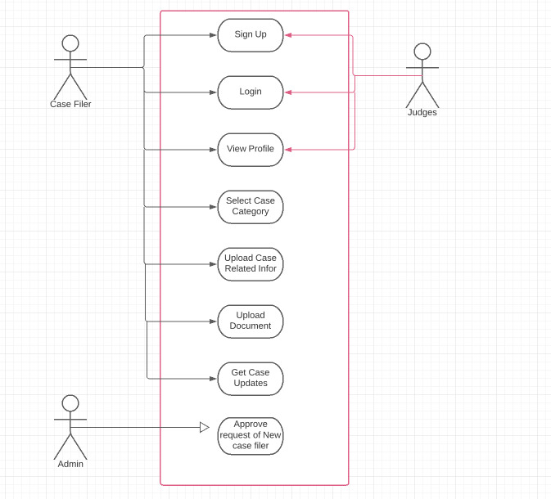
Use Case Diagram
_______________________________

Slide 19
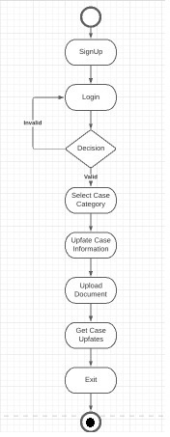
Activity Diagram of Case Filer
_______________________________

Slide 20
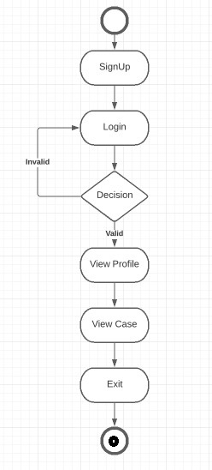
Activity Diagram of Judge
_______________________________

Slide 21
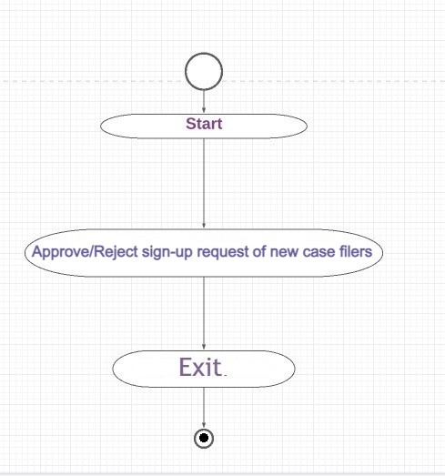
Activity Diagram of Admin
_______________________________

Slide 22
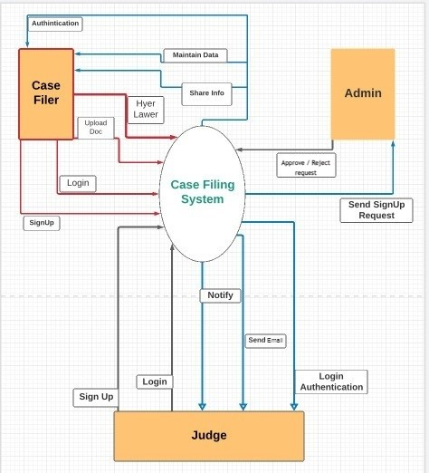
Context Diagram
_______________________________

